Slide 1
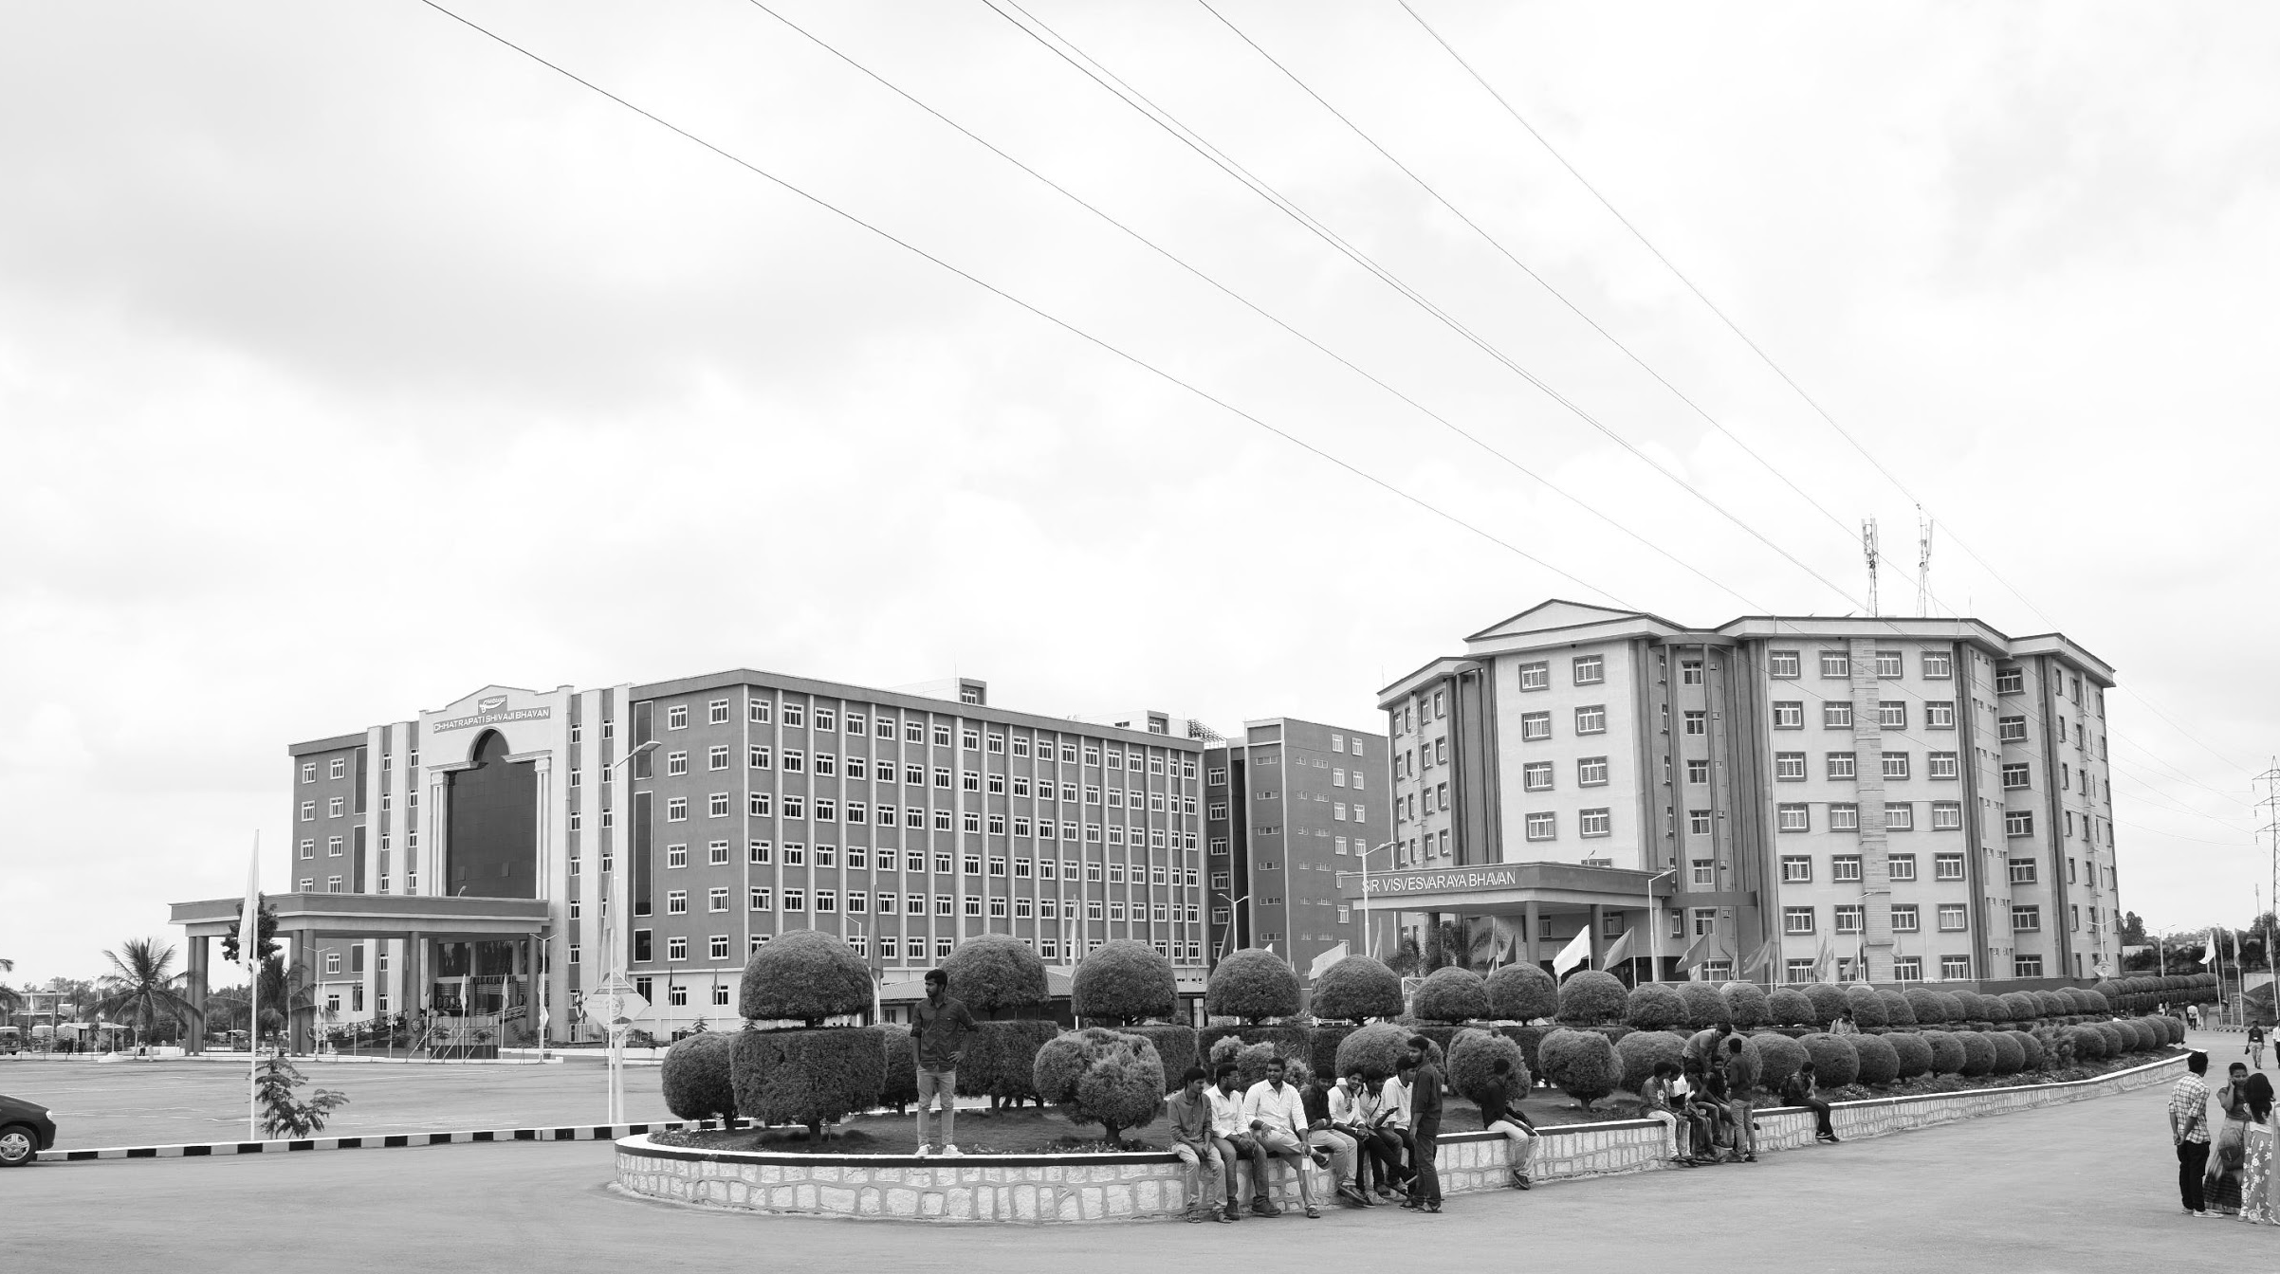

Development of Drone for Emergency Services
Mid-Review 1
Major Project
Project ID: CS17
AY 2021-25
GITAM (Deemed-to-be) University
Project Team:
Jagannath Sagar Karri
Palakonda Visweswara Rao
Department of Electrical Electronics and Communication Engineering
Project Mentor:
Sanhita Manna
Project In-charge:
Dr.Pankaj Kandhway
www.gitam.edu

Slide 2
Objective and Goals
Objective
Brief Description
Objective: The project aims to develop an assistance drone specifically designed to enhance the capabilities of emergency services. The drone will focus on providing real-time situational awareness, reconnaissance, and support for rescue operations in hard-to-reach or disaster-affected areas.
Goals
Main Goals
Implement high-resolution imaging for detailed situational assessment.
Integrate real-time communication capabilities for continuous data transmission.
Achieve a flight time of up to 40 minutes and a 1-kilometer operational range.
Autonomous Navigation complimented with Geo-Fencing
Additional Goals
Ensure the drone can withstand harsh environmental conditions.
Utilize dual-band for reliable communication.
Focus on reducing response times by up to 50%.

Slide 3
20 days
5 days
5 days
5 days
5 days
5 days
5 days
5 days
5 days
5 days
5 days
5 days
5 days
2024
Project Plan
Today
Sep
Oct
Nov
Dec
2024
Sep 1 - Sep 8
Initial Research and Requirement Gathering
Research and Design
Sep 8 - Sep 15
System Architecture Design
Sep 15 - Sep 22
Component Selection and Prototyping
Sep 22 - Oct 20
Integration of Imaging and Communication Systems
Development
Oct 20 - Oct 27
System Integration Testing
Oct 27 - Nov 3
Detailed Performance Testing
Testing and Validation
Nov 3 - Nov 10
Detailed Performance Testing
Nov 10 - Nov 17
Iterative Improvements
Nov 17 - Nov 24
Final Validation Testing
Nov 24 - Dec 1
Preparation for Deployment
Deployment and Documentation
Dec 1 - Dec 8
Preparation for Deployment
Dec 8 - Dec 15
Project Documentation
Dec 15 - Dec 22
Presentation and Project Handover

Slide 4
20 days
5 days
5 days
5 days
5 days
5 days
5 days
5 days
5 days
5 days
5 days
5 days
5 days
2024
Project Plan
Today
Sep
Oct
Nov
Dec
2024
Sep 1 - Sep 8
Initial Research and Requirement Gathering
Research and Design
Sep 8 - Sep 15
System Architecture Design
Sep 15 - Sep 22
Component Selection and Prototyping
Sep 22 - Oct 20
Integration of Imaging and Communication Systems
Development
Oct 20 - Oct 27
System Integration Testing
Oct 27 - Nov 3
Detailed Performance Testing
Testing and Validation
Nov 3 - Nov 10
Detailed Performance Testing
Nov 10 - Nov 17
Iterative Improvements
Nov 17 - Nov 24
Final Validation Testing
Nov 24 - Dec 1
Preparation for Deployment
Deployment and Documentation
Dec 1 - Dec 8
Preparation for Deployment
Dec 8 - Dec 15
Project Documentation
Dec 15 - Dec 22
Presentation and Project Handover

Slide 5
Literature Survey
Key Publications
APPLICATIONS OF UNMANNED AERIAL VEHICLES: A REVIEW
http://dx.doi.org/10.17993/3ctecno.2019.specialissue3.85-105
A review of UAV autonomous navigation in GPS-denied environments
https://doi.org/10.1016/j.robot.2023.104533
Reliable Flying IoT Networks for UAV Disaster Rescue Operations
https://doi.org/10.1155/2018/2572460
UAV- based Photogrammetry and Geocomputing for Hazards and Disaster Risk Monitoring – A Review
https://doi.org/10.1186/s40677-016-0060-y
Key Resources – Whitepaper| Application Notes | Datasheet| Others
Component: Ublox NEO-M8N GPS Module Datasheet
Component: Sharp GP2Y0A21YK0F Analog Distance Sensor Datasheet
Component: HC-SR04 Ultrasonic Distance Sensor datasheet
Existing Implementations – Products| Opensource| GitHub etc
Aerial Drones for Fire Disaster Response
10.5772/intechopen.1002525
DJI ENTERPRISE – Firefightinng
https://enterprise.dji.com/public-safety/firefightingFirefighting

Slide 6
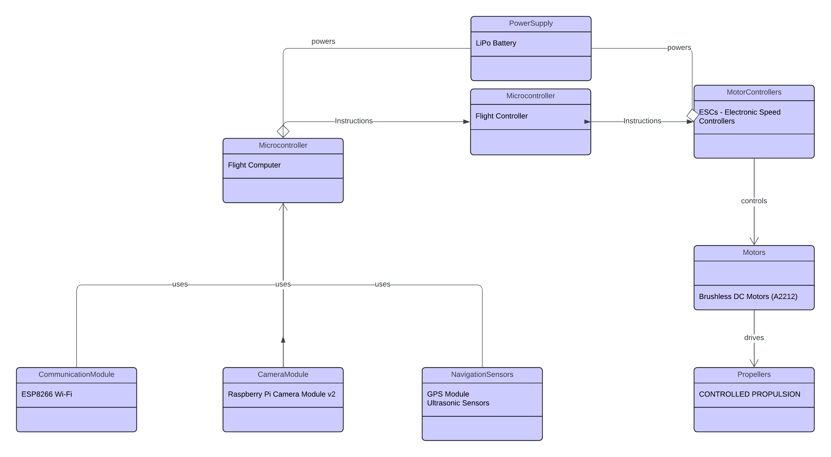
Architecture
Structural Diagram & Behaviour Diagram
Pixhawk 6C
Pixhawk 6C
3dr Radio Telemetry
Drone FPV Camera
Neo – 7M GPS Accelerometers
Gyroscopes
Compass

Slide 7
Use Cases & Testing
Use Cases
Scenario 1: Urban Disaster Site Monitoring: The drone flies over a collapsed building, providing real-time images and thermal scans to locate trapped victims.
Scenario 2: Remote Area Surveillance: In a wildfire scenario, the drone captures high-resolution footage to map fire spread and help direct firefighting efforts.
Scenario 3: Hazardous Environment Assessment: The drone assesses a chemical spill site, providing situational awareness without exposing responders to toxic conditions.
Test Cases
Verify the effectiveness of autonomous navigation in different terrains
.
Test the range and reliability of real-time data transmission under various network conditions.
Evaluate the drone’s durability and performance in harsh environmental conditions (e.g., rain, wind)

Slide 8
Implementation and Results – Iteration 1
Iteration 1 : Results

Slide 9
Implementation and Results – Iteration 2
Iteration : Results + Validation against the use cases and test cases

Slide 10
Implementation and Results – Iteration 3 (Optional)
Iteration : Results + Validation against the use cases and test cases

Slide 11
Contribution
Team Progress and Movement
Jagannath Sagar – Team Lead
Palakonda Visweswara Rao - Hardware
Individual Contribution
Key contributions: Jagannath Sagar
Drone Assembly
Flight Control Systems
Camera Integration
Telemetry Configuration
Autopilot integration
Key contributions: Palakonda Visweswara Rao
Radio systems calibration
Power system setup

Slide 12
Conclusion & Future Work
Summary and Conclusion
Future Work

Slide 13
THANK YOU
Have a Great Day !

